Slide 1
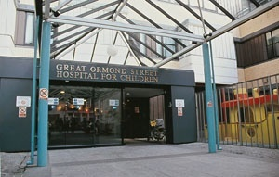
Haematopoietic Stem Cell Gene Therapy
…. moving toward standard of care ?
Hong Kong 2018
2nd International Summit on HUMAN GENOME EDITING
Adrian J Thrasher
UCL Great Ormond Street Institute of Child Health
London WC1N1EH

Slide 2
Disclosures….
Founder and consultant at Orchard Therapeutics.
Consultant for Rocket Pharmaceuticals, Generation bio, and 4Bio Capital Partners

Slide 3
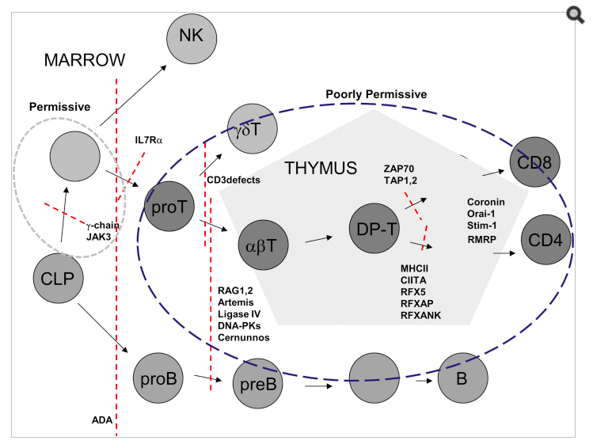
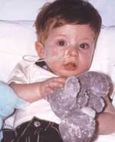
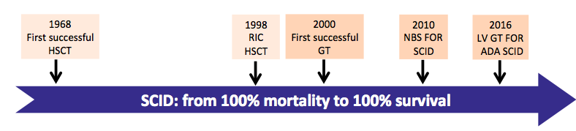
Primary immunodeficiency: a rare disease paradigm....
ME
HSC
Newborn screening
Notes:
Understanding science has allowed elucidation of biological defects and molecular basis of disease.
Development of HSCT
GT

Slide 4
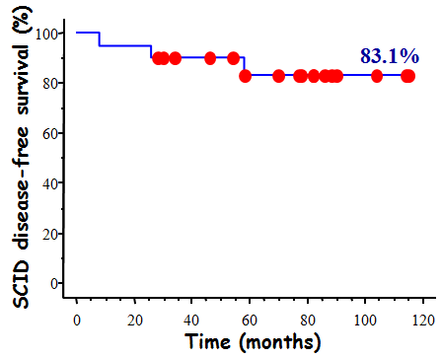
SCID-X1 Gene Therapy (UK/France, 20 patients)
R
U5
IL2RG
R
U5
MoLV
MoLV
SD
SA
9000
*
7000
5000
*
T Lymphocytes/µl
*
*
*
3000
1000
10
20
30
40
50
60
70
80
months after gene therapy

Slide 5
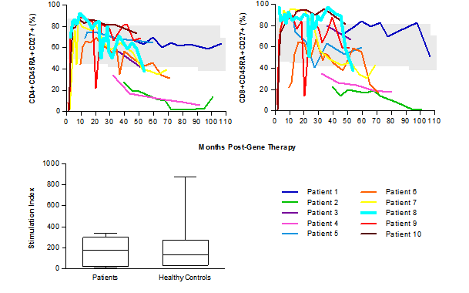
SCID-X1 gene therapy, (UK 10 patients, 10-17yr fu)…

Slide 6
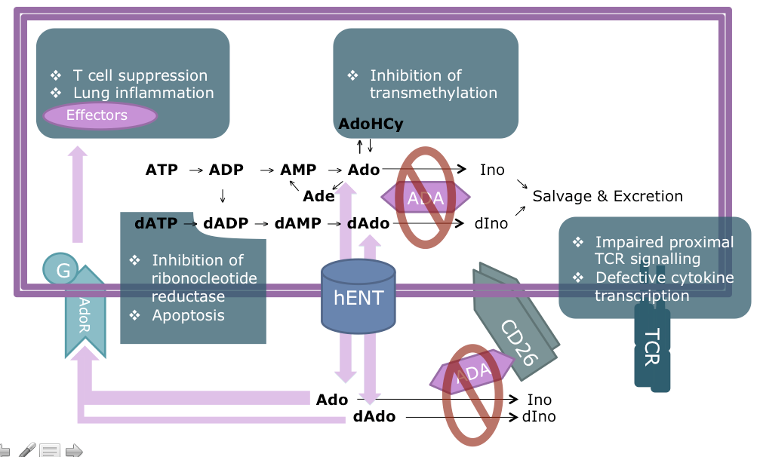
ADA-SCID: disease pathophysiology…

Slide 7
Summary of ADA-Deficient SCID Patients
Retroviral Vectors, Myelosupressive Conditioning
Center | # Pts | F/U (yrs)¹ | Off Enzyme | Survival | DFS²
Milan | 18 | 0.8 – 11.5 | 15/18 | 100% | 83.3%
London | 8 | 0.5 – 7.5 | 4/8 | 100% | 50%
CHLA-NHGRI UCLA-NHGRI | 6 10 | 3–7 0.2-4 | 3/6 9/10 | 100% 100% | 50% 90%
TOTAL | 42 | 0.2 – 11.5 | 31/42 | 100% | 73.8%
¹ As of January 2013
²DFS ≡ Alive without BMT or PEG-ADA re-start
Gaspar, Aiuti, Kohn, unpublished
Notes:
7

Slide 8
SCID-X1 Gene Therapy (UK/France, 20 patients)
MoLV
R
U5
IL2RG
MoLV
R
U5
SD
SA
9000
*
7000
5000
*
T Lymphocytes/µl
*
*
*
3000
1000
10
20
30
40
50
60
70
80
months after gene therapy

Slide 9
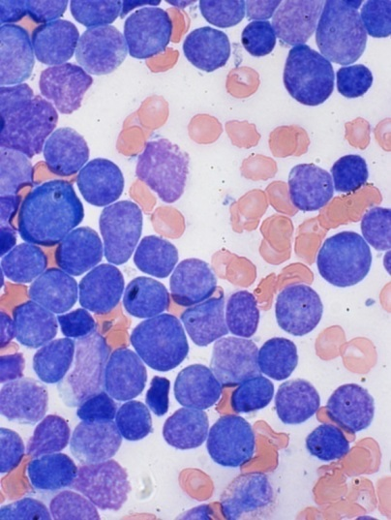
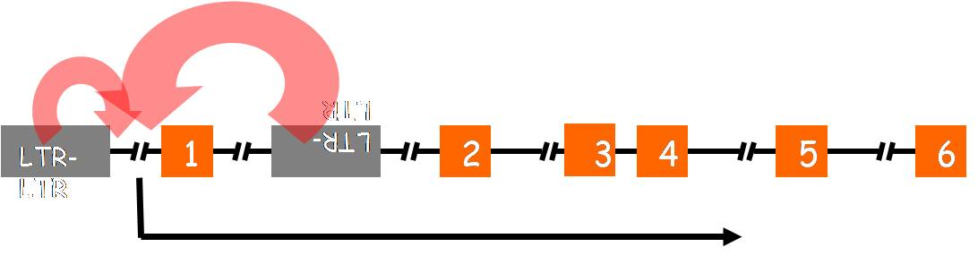
Enhancer-mediated insertional mutagenesis...
Chromosome 11p13
Forward Strand
33.65Mb
33.85Mb
34.05Mb
C11orf41
CD59
FBXO3
LMO2
CAPRIN1
NAT10
ABTB2
VIRUS
INTEGRATION
Fold Difference
X
Relative to:
Leukaemia panel
DP1 T cells
DP2 T cells

Slide 10

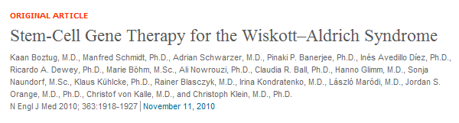

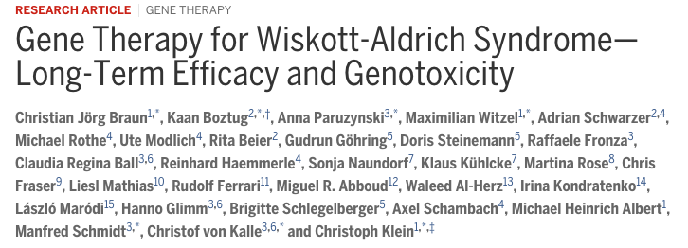
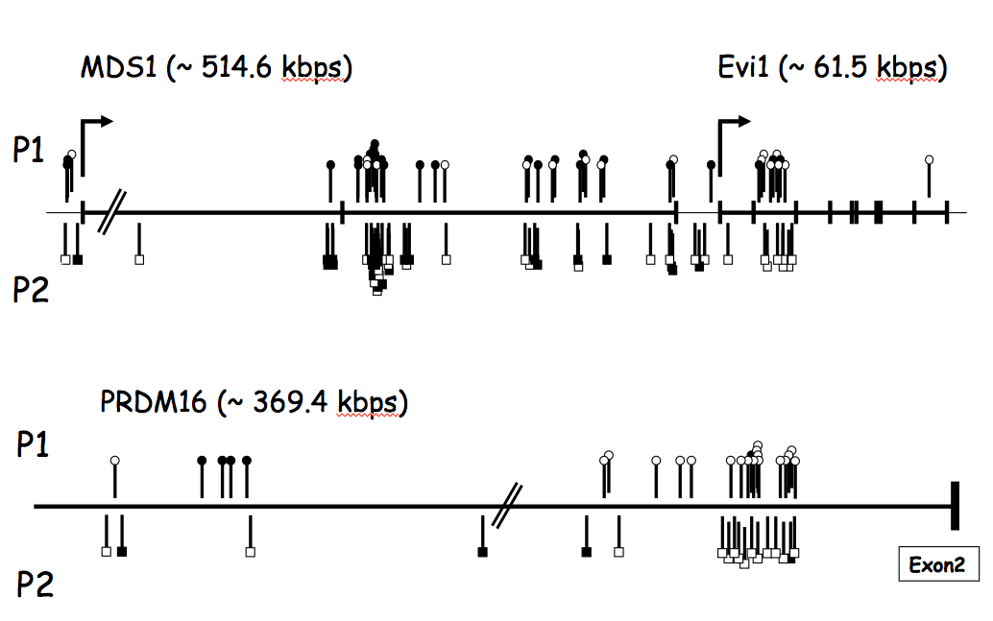

Slide 11
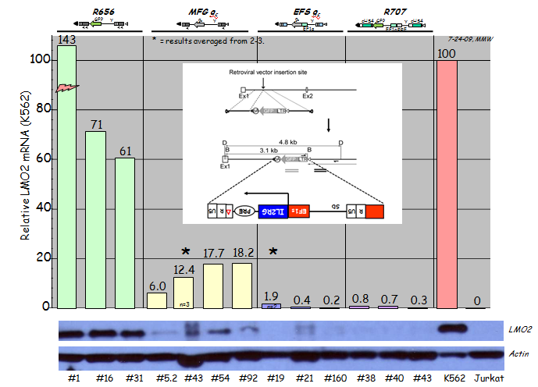
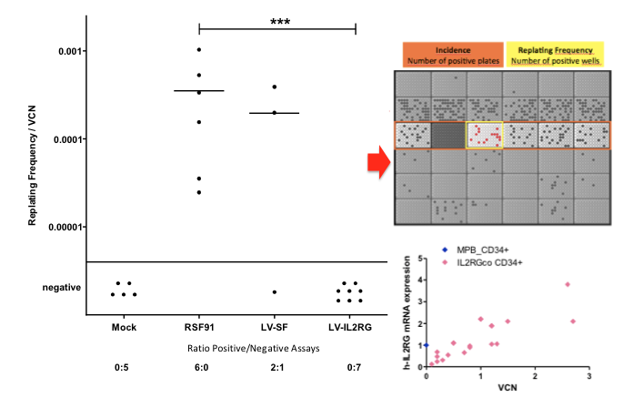
Measuring mutagenesis in vitro....

Slide 12
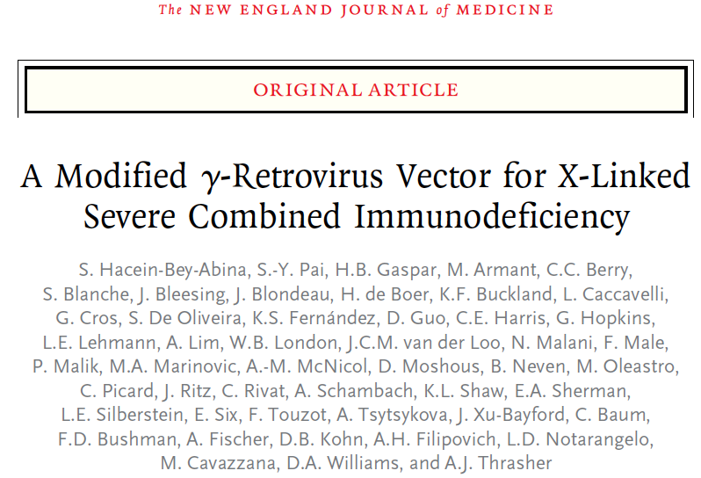
R
U5
EF1s
IL2RG
PRE
Δ
R
U5
SD
Parallel trials in US (Boston, Cincinnati, Los Angeles), Paris, London
Interim efficacy and safety analysis of the first 9 patients enrolled
Median follow-up 29.1 months (12.1-38.7)
No myelosuppressive conditioning

Slide 13
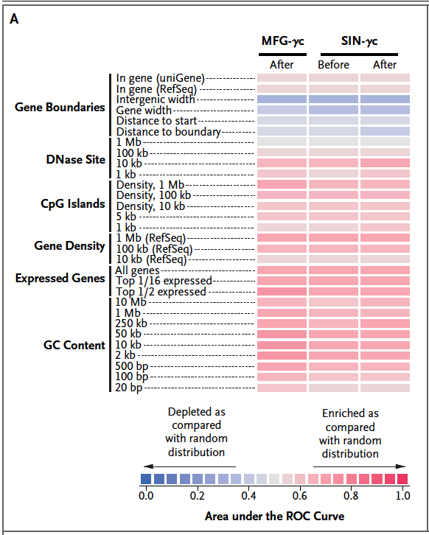
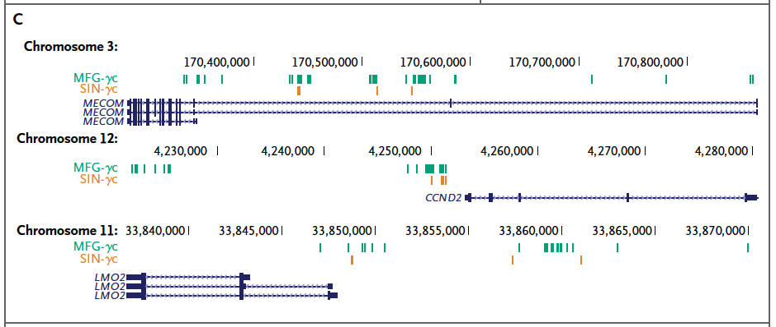
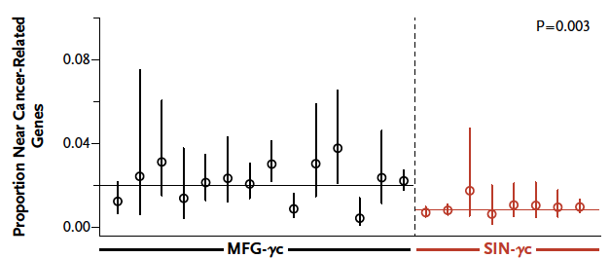
Insertion near lymphoid proto-oncogenes are far less frequent….
Frederic Bushman, University of Pennsylvania
Hacein-Bey-Abina, Pai et al, NEJM 2014

Slide 14
ADA-SCID: disease pathophysiology…

Slide 15
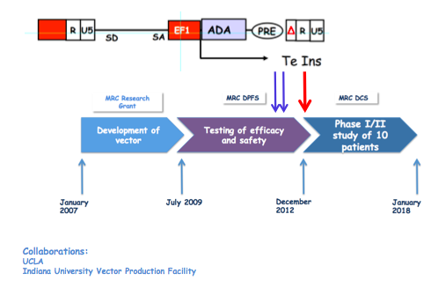
Phase I/II, open-label, non-randomised, trial to assess the
safety and efficacy of EF1αS-ADA lentiviral
vector mediated gene modification of autologous
CD34+ cells from ADA-deficient individuals
UCL-GOSH and UCLA: enrolled >50 patients August 2018

Slide 16
LV gene therapy for ADA SCID (OTL101) – cumulative data
CD34+ cells transduced with lentiviral vector, fresh and cryopreserved formulations
Cohort size | 48 patients treated (follow-up of 1-60 months) as of June 2017
Survival | 100% survival
Immunological and metabolic recovery | Immunological and metabolic recovery in 47/48 patients 47/48 patients with > 6 months follow-up off ERT
Patients off immunoglobulin replacement therapy | majority with > 18 months follow-up off IgRT
Risk of leukaemia | No evidence of persistent clonal dominance

Slide 17
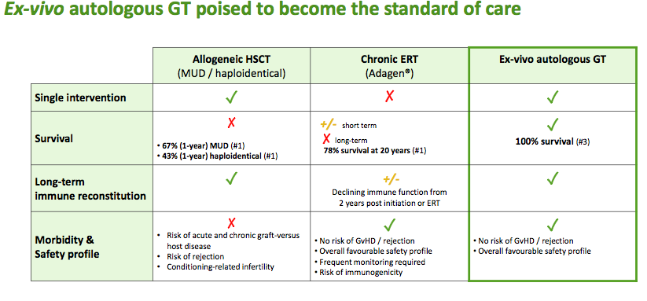
Choice of therapies….

Slide 18
Broadening HSC gene therapy landscape……
~200 patients and rising

Slide 19
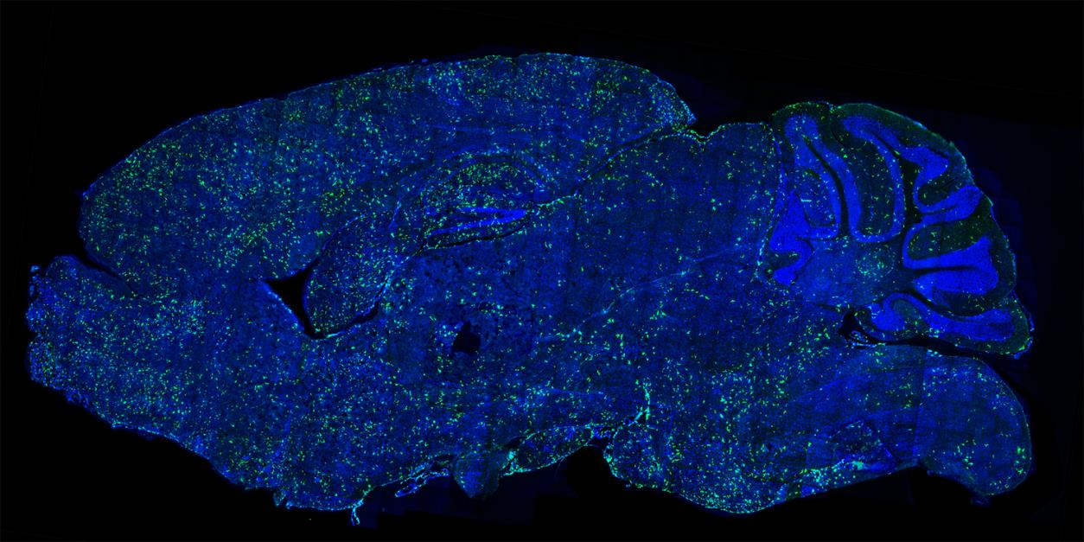



HSC gene therapy: delivery of proteins to other tissues Potential to treat diseases with CNS manifestations
Distribution of genetically modified cells in mouse brain
HSC-derived myeloid cells migrate into brain across BBB
Source: Capotondo et al. PNAS 2012;109:15018-15023
Brain of a wildtype mouse transplanted with GFP-LV transduced HSPCs after Busulfan conditioning Green = GFP (green fluorescent protein); blue = nuclei staining Morphology of the ramified parenchymal cells resemble microglia at different stages of maturation (source: A. Biffi)

Slide 20
MLD: preservation of motor and cognitive function (Biffi et al.)
Treated with OTL-200
Untreated
Chronological age (months)
Chronological age (months)
Motor function stable or comparable to healthy participants in 7/9 patients
Cognitive function within normal range in 8/9 patients
GMFM: gross motor function measure
Data from Sessa (Lancet Neurology 2016) in 9 patients. Median follow-up: 36 months (18-54 months)

Slide 21
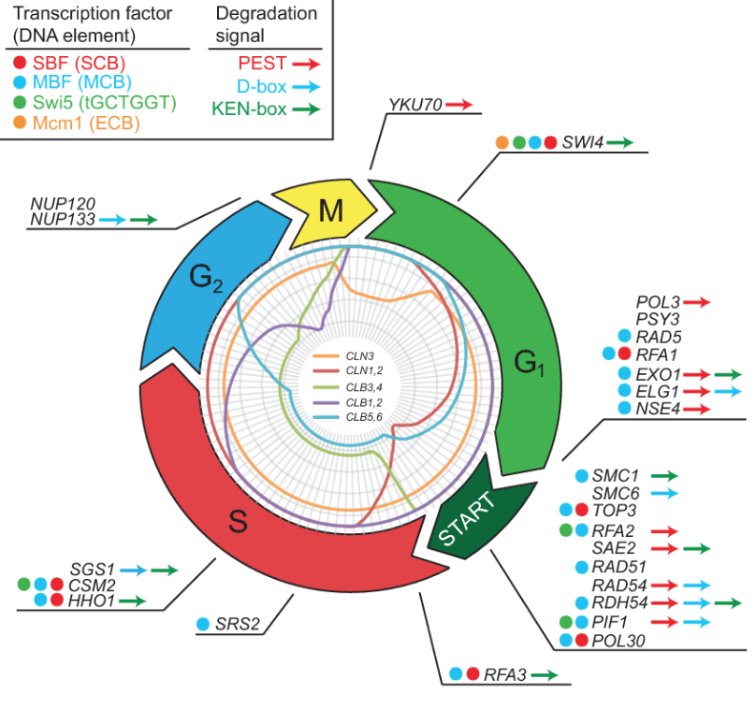
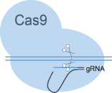
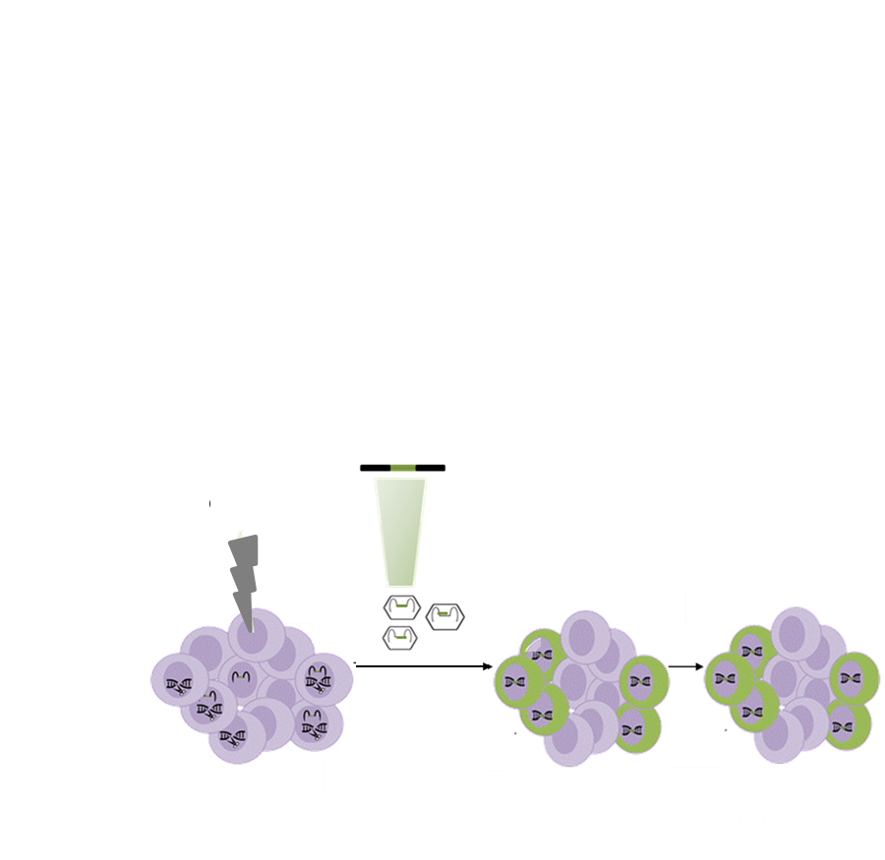
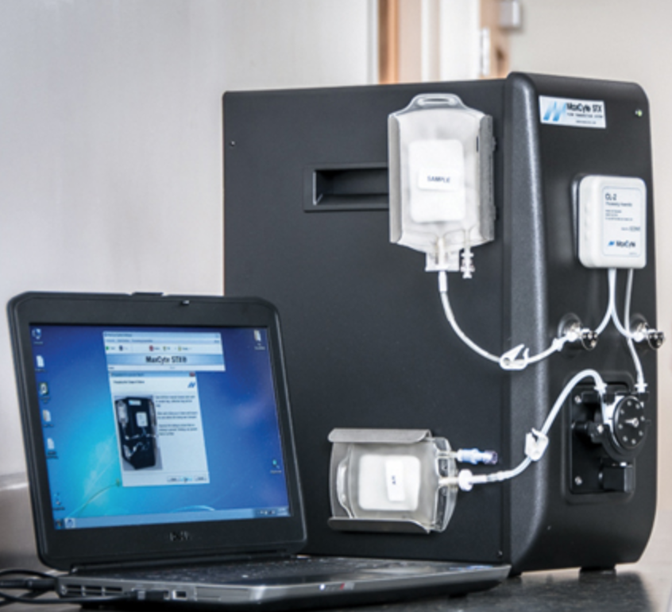
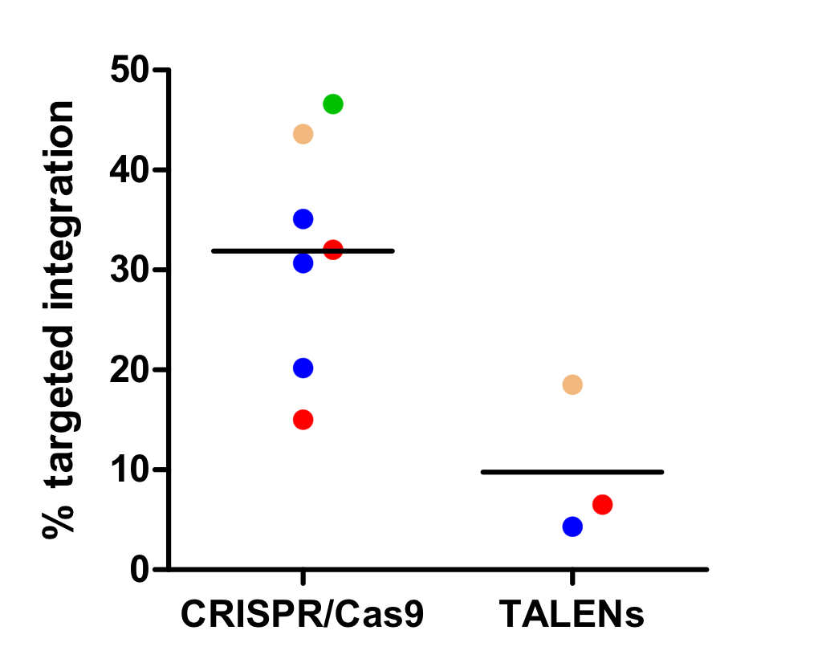
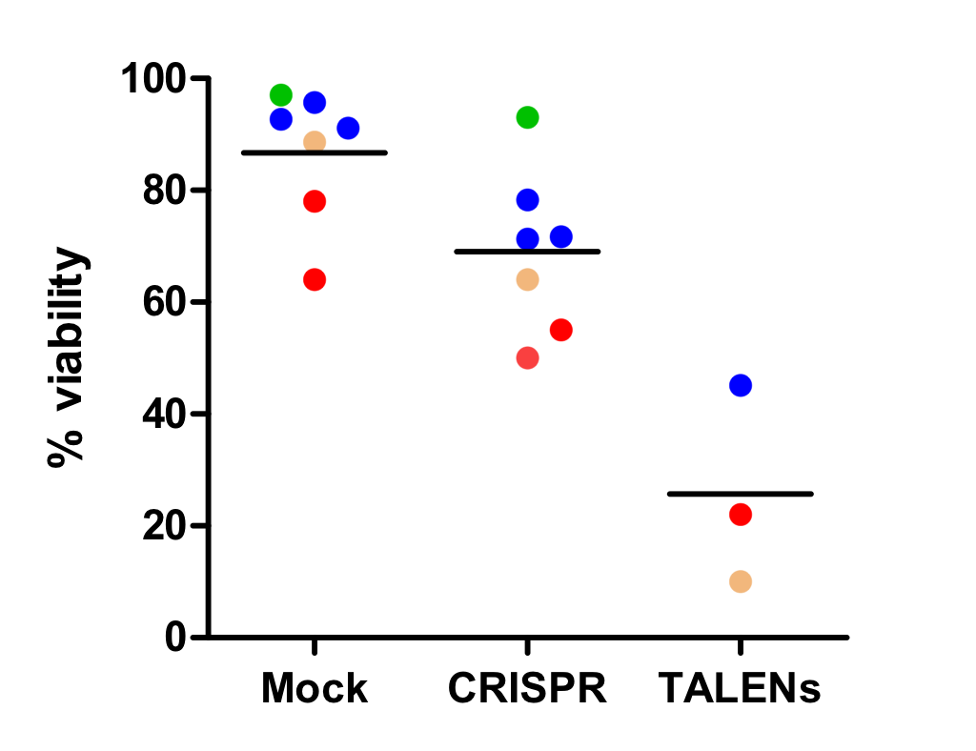
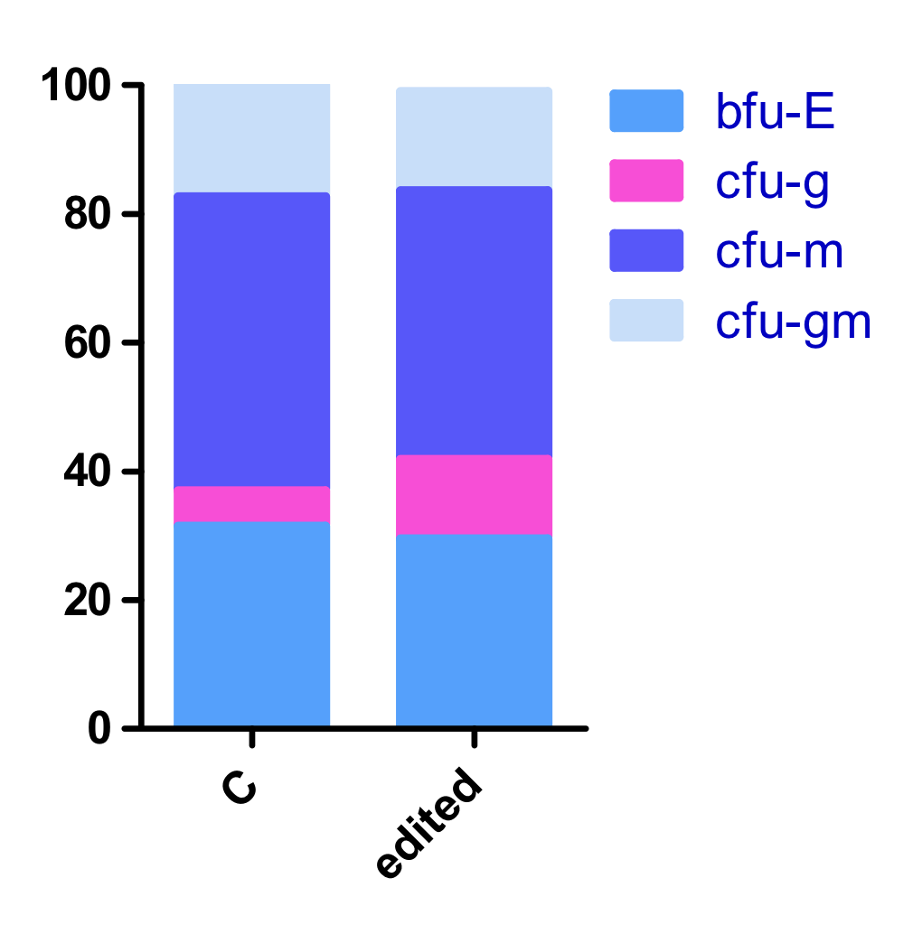
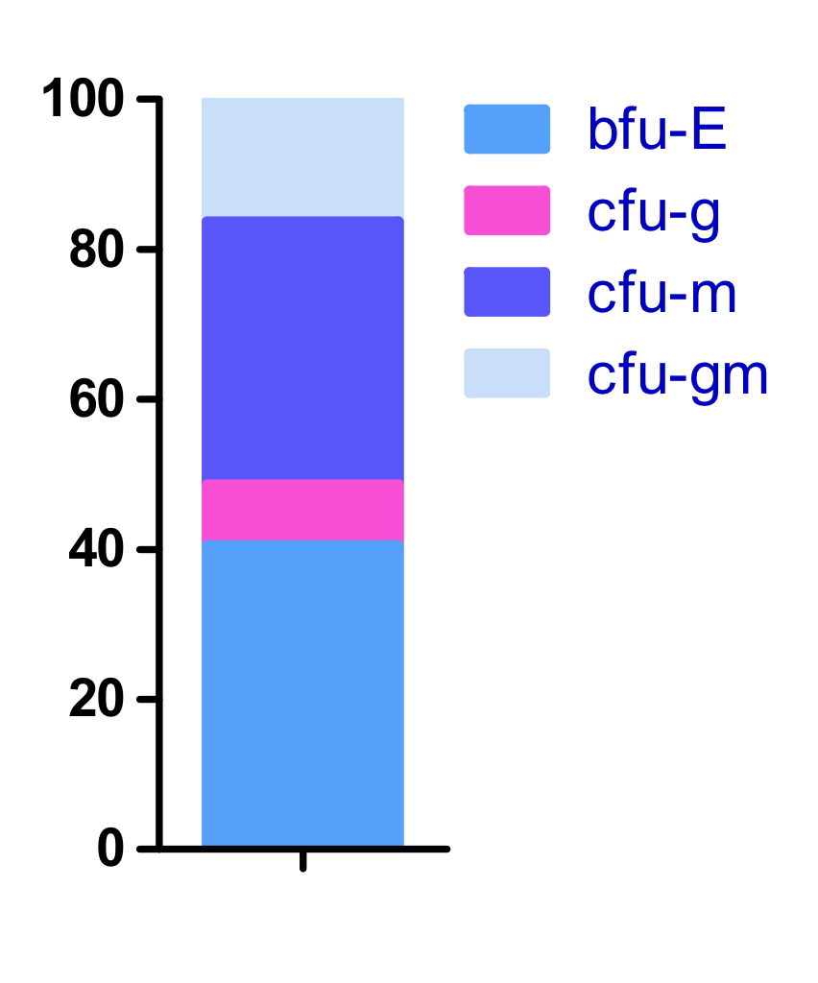
Efficient knock-in of a PGK-GFP cassette into the WAS locus in HSPCs
Gene editing: efficient targeting of HSPCs ?…
HA
PGK-GFP
HA
Genome editing in HSPCs
AAV6 donor vector
GFP+ cells
Day 14
gRNA
MS-gRNA
PGK-GFP knock-in in HSPCs
Colony forming efficiency in edited HSPCs
ns
BFU-E
CFU-G
CFU-M
CFU-GM
Colony formation (%)
Colony formation (%)
RNP+AAV
Mock
GFP+ cells
No lineage skewing observed in vitro

Slide 22

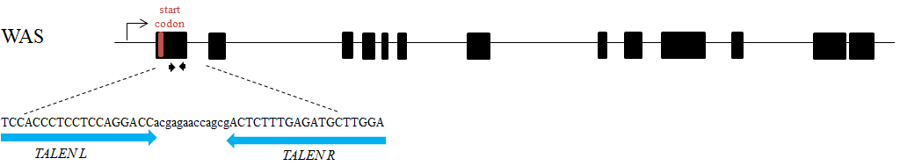
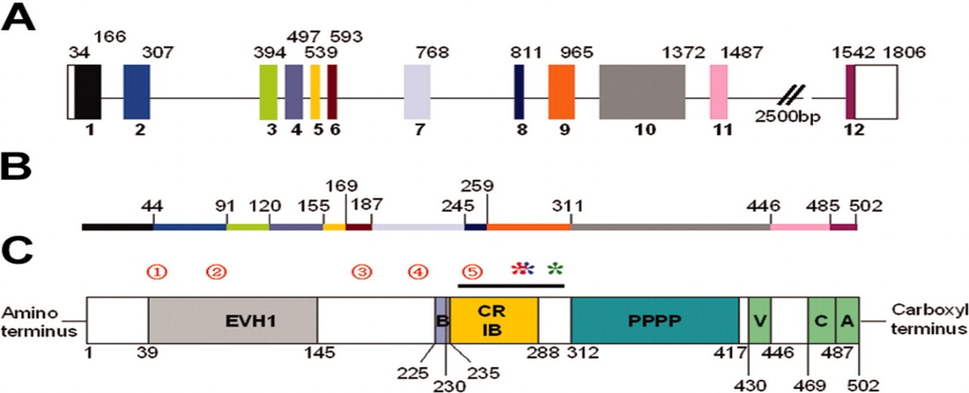
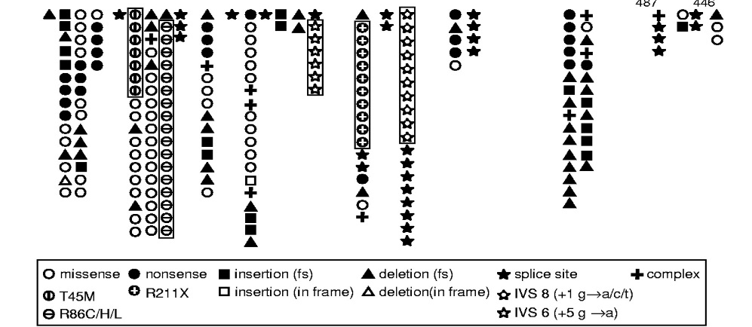
Gene editing strategy
Gene editing approaches for WAS…
Alessia Cavazza
Gene editing strategy
Gene editing tools
ATG
gRNA
Cas9
Ex1
WAS locus
WAS
locus
*
HA
coWAS
HA
Donor template
Ex1
Ex2
AAV6
ATG
Edited locus
HA
coWAS
HA
coWAS
Ex1
WAS gene

Slide 23
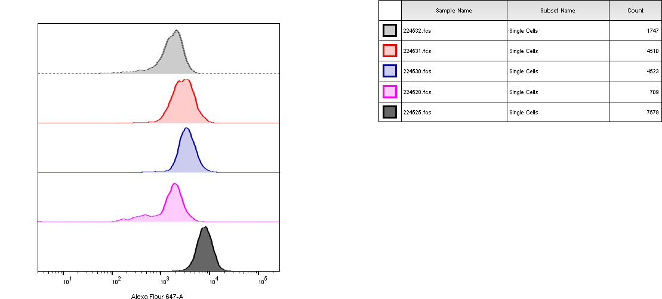
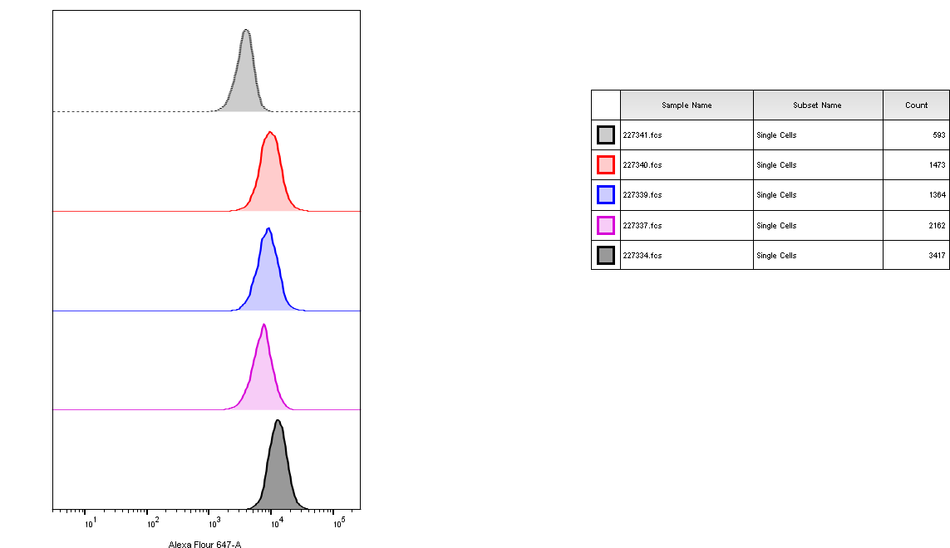
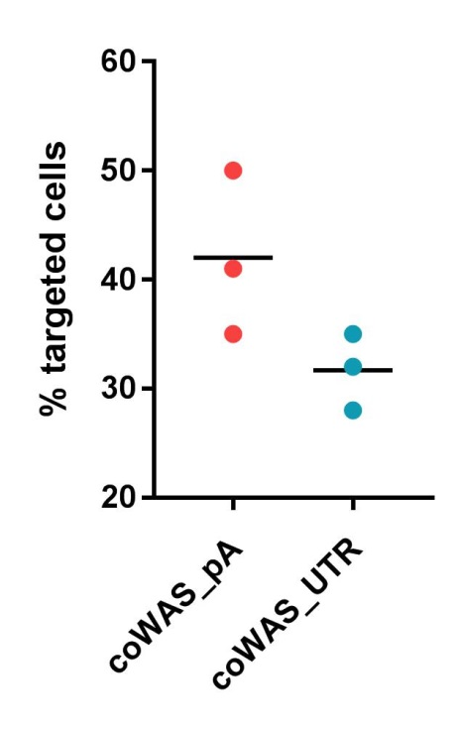
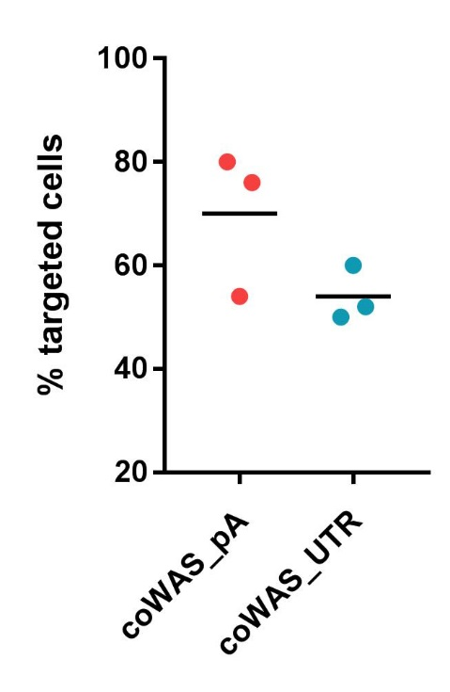
Genome targeting restores WASP expression in WASP^{-/-} HSPCs
Successful editing of WAS HSPCs…
in vitro differentiation
WASP^{-/-} HSPCs
Macrophages
WASP expression (FACS)
Gene Targeting (ddPCR)
WASP expression (FACS)
Gene Targeting (ddPCR)
ddPCR
WASP^{-/-}
ddPCR
WASP^{-/-}
coWAS_pA
coWAS_pA
count
coWAS_UTR
count
coWAS_UTR
WW1.6
WW1.6
WT
WT
coWAS
pA
coWAS
UTR
coWAS
pA
coWAS
UTR
WASP
WASP
 | coWAS_pA | coWAS_UTR | WW1.6
mean WASP % | 40 | 25 | 5
Copy Number | 1 | 1 | 1.2
 | coWAS_pA | coWAS_UTR | WW1.6
mean WASP % | 75 | 45 | 20
Copy Number | 1 | 1 | 3.5

Slide 24
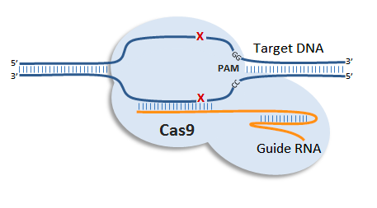
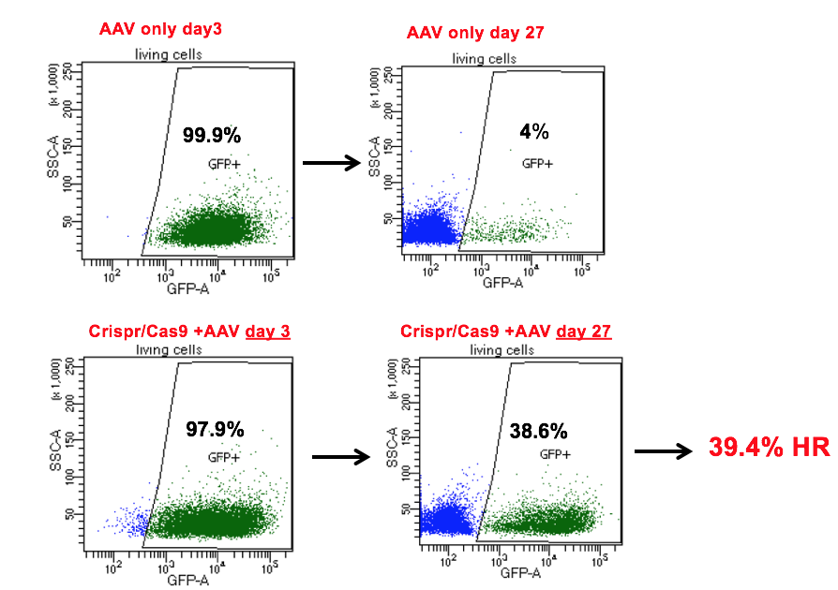
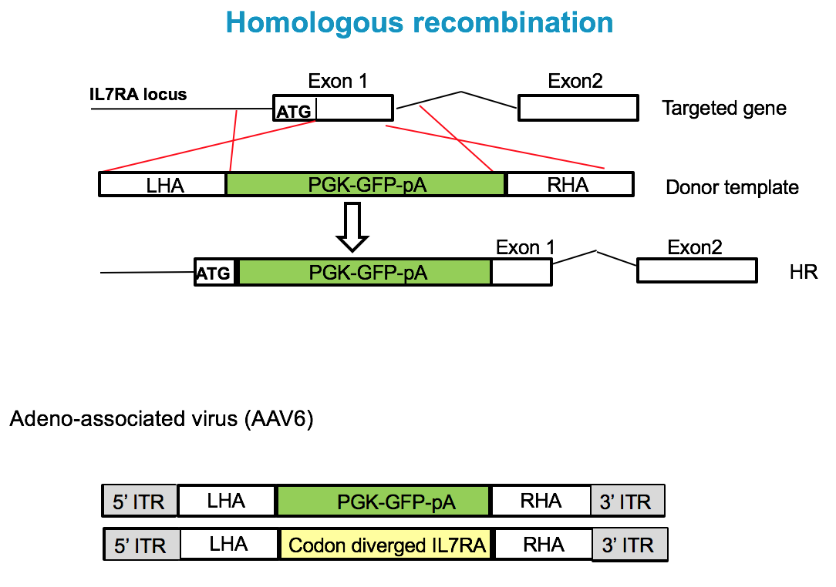
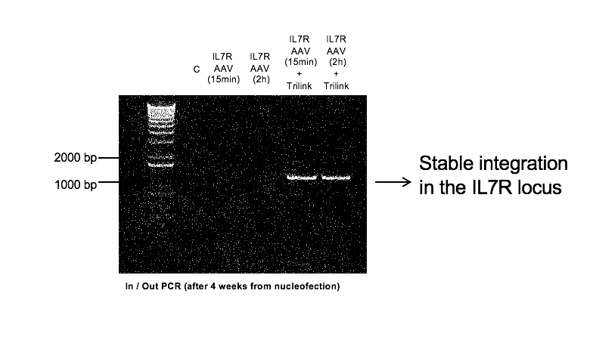
Gene editing and repair: CRISPR Cas9 IL7Ra SCID.....

Slide 25
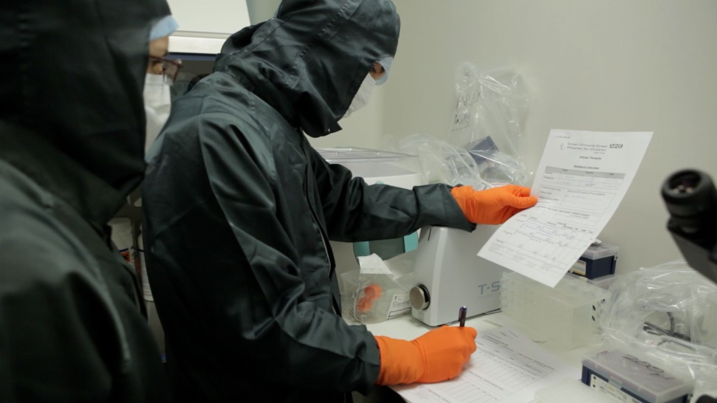
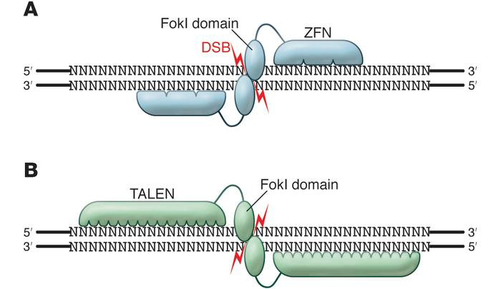
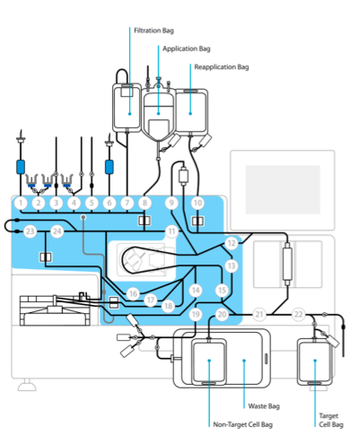
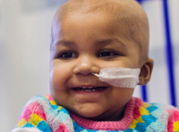
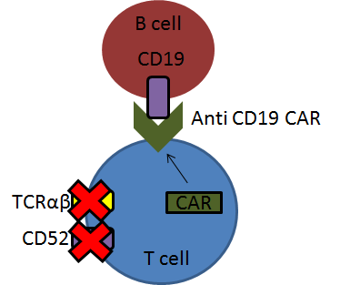
Technological innovation and new targets…
Efficient gene editing in allogeneic T cells (Qasim, Veys…)….
Notes:
Establishment of effective infrastructure has allowed us to broaded applications to other diseases including metabolic and paediatric cancer

Slide 26
Primary immunodeficiency: a rare disease paradigm....
ME
HSC
Newborn screening
Notes:
Understanding science has allowed elucidation of biological defects and molecular basis of disease.
Development of HSCT
GT

Slide 27
Many thanks to….
Institute of Child Health
Giorgia Santilli
Alessia Cavazza
Fang Zhang
Kimberly Gilmour
Sue Swift
Claudia Montiel Equiha
Marlene Carmo
Christine Rivat
Ben Houghton
Claire Booth
Karen Buckland
Cecile Duret
Harvinder Hara
Diego Leon
Alison Niewrowska
Bobby Gaspar
Great Ormond Street Hospital
Paul Veys
Persis Amrolia
Kanchan Rao
Graham Davies
Waseem Qasim
Austen Worth
Jinhua Xu-Bayford
Katie Snell
Nursing and support staff
Stuart Adams
Collaborators
David Williams
Luigi Notarangelo
Sung-Yun Pai
Lisa Filipovich
Chris Baum
Axel Schambach
Christof von Kalle
Manfred Schmidt
Rick Bushman
Marina Cavazzana
Alain Fischer
Salima Hacein-Bey
Don Kohn
Denise Carbonaro Sarracino
Manuel Grez
Harry Malech
Anne Galy
Fulvio Mavilio
Sabine Charrier
Juan Bueren
Paula Rio
Elena Almarza

Slide 28








California Institute of Regenerative Medicine (CIRM)
NHLBI GTRP; NIAID Intramural Program

